Slide 1
Test &GO

Slide 2
Special Offers
Test&GO
Retail the New Way
Cegid remains by your side during these uncertain times. To help support you, we’ve launched a range of
‘Test&GO’ offers. New shopping scenarios (click & collect, order in store, ship from store), managing single stock, the new role of in-store sales associates, in-store mobility and real-time intelligence… retail is constantly changing.
We invite you to take a look at this catalogue of offers to help you respond to these changes and
Retail the New Way.

Slide 3
WHY HAVE WE LAUNCHED test&GO?
Omnichannel, digital store transformation and real time are no longer an option.
Special Offers
Test&GO
Retail the New Way
Your customers expect to shop via any channel and touchpoint offline (own stores, shop in shops etc.) and online (web, social media, market place). They expect a a seamless and consistent shopping experience. Along side intense economic pressure in retail, this means that your stores have to adapt and staff roles and expectations are changing.

Slide 4
HOW? WITH A UNIQUE OFFER TO HELP YOU EXECUTE YOUR OMNICHANNEL STRATEGY.
Single Stock Management: Gain a single, real-time view of your stock and optimise fulfilment with Cegid’s Order Management (OMS) and Distributed Order Management (DOM) modules.
Omnichannel Scenarios: Address all key shopping scenarios, like Click & Collect, E-reservations, Order In-store to maximise sales opportunities.
Ship from Store: Turn your physical stores into logistics hubs and fulfil customer orders quickly, efficiently and in the most sustainable way possible.
Special Offers Test&GO Omnichannel

Slide 5
EMPOWER YOUR SALES ASSOCIATES WITH DIGITAL TOOLS TO BETTER-SERVE YOUR CUSTOMERS.
Transformation of Stores and Store Associates: Your stores must evolve to become a point of service, a place to experience and a logistics hub. To carry out these demands, store associates need both back & front store mobile tools to better serve, sell, fulfil orders, manage stock etc.
Agility through Retail Intelligence: Your employees, store associates, managers and directors must have real-time data, intuitive dashboards and insights to understand key trends, to make informed decisions and keep track of KPIs.
Special Offers
Test&GO
Retail the New Way

Slide 6
DISCOVER THE ‘test&go’* OFFERS.
Solution : Cegid Retail Y2
Modules : All Omnichannel modules, Retail Intelligence, Inventory Tracking, Mobile POS + SaaS migration.
For : All retailers
Mode : SaaS | On Premise
Type : Test&GO*
Duration : 3 month trial (from date of signed order). 36 month commitment (if accepted) following trial period.
Services : Special services offer available. Please contact your local Cegid sales representative for more information.
Test&GO Catalogue
*You can test the Cegid Retail modules free for 3 months (excluding service costs), for any enrolments before 30th April 2021, as set out in the terms and conditions of the Test&GO Agreement. This offer cannot be accumulated with any other offers.

Slide 7
Test&GO Offer
Omnichannel
Retail the New Way
Accelerate your omnichannel transformation and increase opportunities to sell and serve your customers, .
Solution : Cegid Retail Y2
Modules : All Omnichannel modules |OMS|DOM
For : All retailers
Mode : SaaS | On Premise
Type : Test&GO*
Duration : 3 month trial (from date of signed order) + 36 month commitment (if accepted) following trial period.
Services : Special services offer available. Please contact your local Cegid sales representative for more information.
Offer valid until 30th April 2021
All shopping scenarios : rapidly deploy all omnichannel services available in Cegid Retail Y2: Click & Collect | Order In Store | E-Reservation | Ship from Store
Ship from Store : Transform your stores into logistics hubs and fulfil online orders from the most convenient, cost-effective location and in the most sustainable way possible.
Manage single stock and order orchestration: Gain a single, real-time view of your stock and optimise order fulfilment.

*La possibilité de tester gratuitement les modules de Cegid Retail pendant 3 mois (hors coûts liés aux prestations de service), pour toute souscription à l’offre avant le 30 avril 2021, dans les conditions figurant au Test&Go Agreement. Offre non cumulable avec d’autres offres en cours.

Slide 8
Test&GO Offer
Mobile POS
Retail the New Way
Rethink the in-store customer journey. Reduce wait times, make queuing a thing of the past and deliver a seamless and stressless experience.​
Social distancing, sanitiser stations, contactless shopping and payments…retail won’t be the same for some time. Nonetheless, providing safe and personalised service will still be what sets apart those that will succeed - all be it with less human contact. It’s now even more important to digitise your stores and empower staff with mobile tools to improve the shopping experience and help drive more sales..
From now on, your store associates will be able to:
Share real-time information with the customer, quickly and efficiently
Process multiple omnichannel orders in a single basket
Accelerate the sales process thanks to‘ Queue Busting’
Fulfil online orders from the store
Manage sales – with contactless payment
And much more!
Solution : Cegid Retail Y2
Modules : Mobile POS
For : All retailers
Mode : SaaS | On Premise
Type : Test&GO*
Duration : 3 month trial (from date of signed order) + 36 month commitment (if accepted) following trial period.
Services : Special services offer available. Please contact your local Cegid sales representative for more information.
Offer valid until 30th April 2021

*La possibilité de tester gratuitement les modules de Cegid Retail pendant 3 mois (hors coûts liés aux prestations de service), pour toute souscription à l’offre avant le 30 avril 2021, dans les conditions figurant au Test&Go Agreement. Offre non cumulable avec d’autres offres en cours.

Slide 9
Test&GO Offer
Inventory Tracking
Retail the New Way
Rethink your store’s back-office logistics and accelerate your omnichannel strategy.
​
It’s vital to put in place omnichannel services and tools that will help you manage stock across multiple channels. You need to do everything you can to get more productivity out of your stores and staff.​
​
Take advantage of Test&GO Inventory Tracking. This mobile “back-store” logistics solution is specially designed to manage inventory for inter-store transfers, for checking deliveries, to manage omnichannel picking etc.​
Solution : Cegid Retail Y2
Modules : Inventory Tracking
For: all retailers
Mode : SaaS | On Premise
Type : Test&GO*
Duration : 3 month trial (from date of signed order) + 36 month commitment (if accepted) following trial period.
Services : Special services offer available. Please contact your local Cegid sales representative for more information.
Offer valid until 30th April 2021

Quick to set up with a rapid ROI​
Significant productivity gains​
Improved responsiveness in the current economic climate​
Easy adoption and use by staff​
*La possibilité de tester gratuitement les modules de Cegid Retail pendant 3 mois (hors coûts liés aux prestations de service), pour toute souscription à l’offre avant le 30 avril 2021, dans les conditions figurant au Test&Go Agreement. Offre non cumulable avec d’autres offres en cours.

Slide 10
Test&GO Offer
Retail Intelligence
Retail the New Way
Optimise decision making and increase agility; both essential to Retail the New Way.
With our Retail Intelligence tool, you will be able to :
Rapidly analyse large volumes of data
Identify key trends and highlight key areas of concern
Gain a greater understanding of your customers and the impact of your marketing efforts
Optimise the flow of stock to your stores
Benchmark against your key competitors
Fine-tuning stock levels will enable you to:
Determine the most effective promotions to shift stock and plan seasonal activities
Optimise inventory & replenishment
Solution : Cegid Retail Y2
Modules : Retail Intelligence
For: All retailers
Mode : SaaS | On Premise
Type : Test&GO*
Duration: 3 month trial (from date of signed order) + 36 month commitment (if accepted) following trial period.
Services : Special services offer available. Please contact your local Cegid sales representative for more information.
Offer valid until 30th April 2021

*La possibilité de tester gratuitement les modules de Cegid Retail pendant 3 mois (hors coûts liés aux prestations de service), pour toute souscription à l’offre avant le 30 avril 2021, dans les conditions figurant au Test&Go Agreement. Offre non cumulable avec d’autres offres en cours.

Slide 11
More about Cegid Retail’s Unified Commerce Platform
Adopt New ways to serve, sell and fulfil

Slide 12
Stores, sales associates are ill-equipped, ill-informed to deliver on omnichannel service expectations and lack real time information on customers, products, etc. leading to lost sales and customer frustration

Empower new roles of physical Store & Associates
Notes:
Lt
In order to provide dynamic customer experience, retailers have to empower their workforce through connected solutions allowing them to deliver optimal levels of service, remotely access pertinent consumer and product information, simplify their daily operations or encourage top-down communications.
Lorsqu’ils recherchent un nouveau logiciel de gestion, nos clients sont immanquablement confrontés à la même réponse de la plupart des fournisseurs du marché : « Nous allons étudier vos besoins afin de vous proposer une solution adaptée ». En d’autres termes, ils ont en face des fournisseurs qui ne connaissent pas bien leur métier ou leurs enjeux business d’aujourd’hui et encore moins de demain.
Or nos clients ont besoin d’un partenaire spécialiste de leur métier pour qu’ils puissent aller vite et saisir toutes les opportunités.

Slide 13
Digitise the stores, associates in the scope of their new roles.
Retail before:
Direct sales
Customer returns
Receiving products
Warehouse returns
Retail now
Direct sales
Omnichannel customer returns
Goods’ collection
Endless aisle
Receiving products
Warehouse returns
Distant selling
Order preparation for ship from store
More stock counting
And more…
Increased roles & complexity for sales associates
Notes:
Lt
Click on the icon inside the red marker to zoom in on that step.
To cancel, click on corner grid icon to go back to Omnichannel grid.

Slide 14
Single omnichannel basket & Demo
Fulfill BOPIS orders
Easily generate additional sales
Checkout with customers in a one-on-one experience

Slide 15
Guarantee a real-time visibility & Demo
Real-Time visibility & accurate levels of stock availability
High level of speed & accuracy in fulfilment execution
Improve management of on-hand inventory and avoid “dead” inventory

Slide 16
Stock is siloed, inaccurate nor visible across the retailers’ entire estate leading to lost sales, over-under stocks, excessive costs, detrimental to environment, eroding profits…

Optimise Inventory, fulfilment, omni. order management through real-time single stock [OMS-DOM]
Notes:
Yal
Stock is the issue. Siloed info / Outdated stock info
Multiplicity of devices and apps for omnichannel Processes
Poor exécution of omni processes
Covid / Dark Stores évolutions 2020. Acceleration of omnichannel trends

Slide 17
Optimise omnichannel fulfilment & Minimise costs
Distributed Order Management DOM/OMS
Smart Allocation motor
Collaborative Allocation
Leveraging store network, locations (Ship from Store)
Available Stock
& stock rotation
Stock type priority
(store, WH, etc.)
Min. Stock coverage
Preparation and shipping costs
Customer rating
Geographical proximity
Delivery time
Carrier / Routes
Notes:
Ok

Slide 18
●
Too much data, difficult to exploit, lack of consolidated real time vision to make the right decision at the right moment
Execute Data-Driven approach: Smart Analytics, Sales Benchmark
Notes:
yalLorsqu’ils recherchent un nouveau logiciel de gestion, nos clients sont immanquablement confrontés à la même réponse de la plupart des fournisseurs du marché : « Nous allons étudier vos besoins afin de vous proposer une solution adaptée ». En d’autres termes, ils ont en face des fournisseurs qui ne connaissent pas bien leur métier ou leurs enjeux business d’aujourd’hui et encore moins de demain.
Or nos clients ont besoin d’un partenaire spécialiste de leur métier pour qu’ils puissent aller vite et saisir toutes les opportunités.

Slide 19
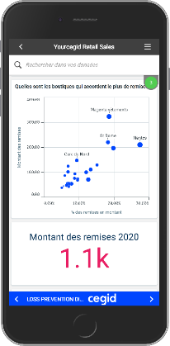
Cegid Retail Intelligence Stack
1.OPEN
2. RETAIL MINDED
3. OPTIMISED ROI
Import of External Data
Export to Retailer’s Datalake
Extensible
+600 Retail KPIs +80 Operationnal Reports
+20 Analytics & Dashboard
Self-Service BI Responsive
2 days training to adopt
Notes:
Data has

Slide 20
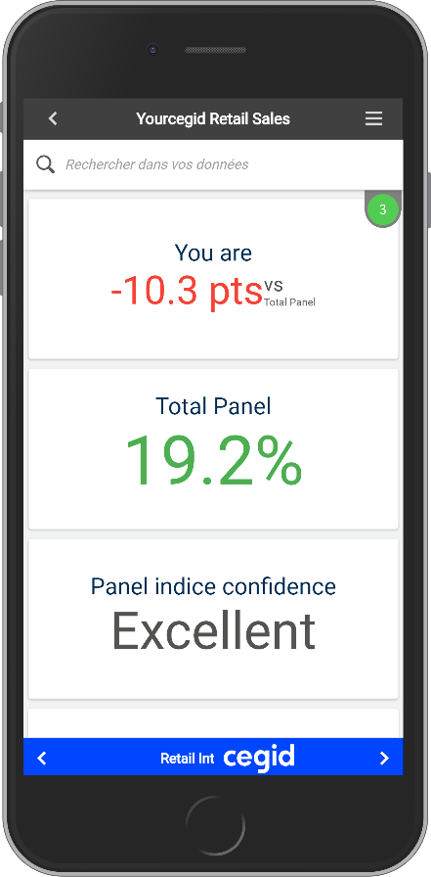
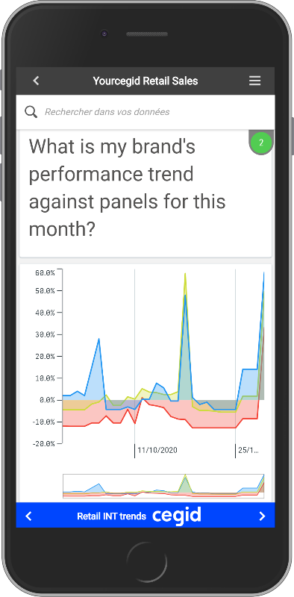
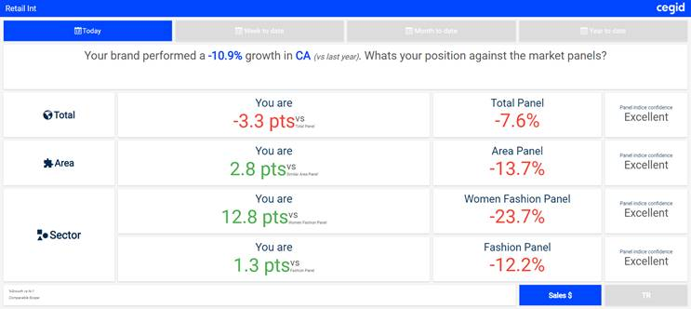
Data as a Service & Benchmark
Consolidate data flows from POS and retail operations
40+ pre-built templates available in one click with Cegid retail’s Self-Service dashbaords
SaaS or on premise
Extensible Third –party data integration
Feed you own data lakes / data marts with Cegid retail Intelligence data

Slide 21
Siloed, disparate systems from one country, inconsistent selling ceremonies, lack of central management, compliance
❍
Compliancy WW
& Single Retail Solution WW
Notes:
Och
Lorsqu’ils recherchent un nouveau logiciel de gestion, nos clients sont immanquablement confrontés à la même réponse de la plupart des fournisseurs du marché : « Nous allons étudier vos besoins afin de vous proposer une solution adaptée ». En d’autres termes, ils ont en face des fournisseurs qui ne connaissent pas bien leur métier ou leurs enjeux business d’aujourd’hui et encore moins de demain.
Or nos clients ont besoin d’un partenaire spécialiste de leur métier pour qu’ils puissent aller vite et saisir toutes les opportunités.

Slide 22
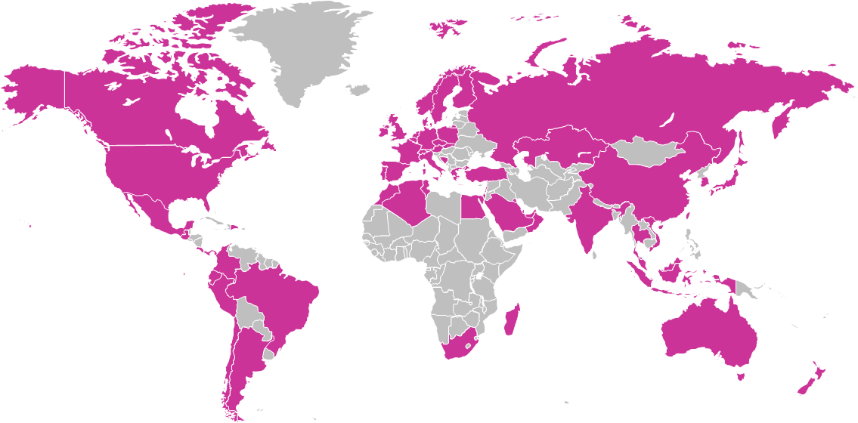
Compliant Now & in the Future
Single WW Platform
23 langages
69 country packages
4 Datacenters (EU,US,APAC,China)
Commitment to legal future evolutions
Dedicated Compliance Team
Cegid Retail
Personal Data Protection
Fiscal Reporting
Taxes
Fiscal Devices
Retail practices

Slide 23
Global coverage
23 Languages
Arabic
American English
Czech
Dutch
English
French
German
Greek
Italian
Japanese
Korean
Polish
Portuguese
Russian
Simplified Chinese
Slovak
Spanish
Swedish
Thai
Traditional Chinese
Turkish
Vietnamese
69 country packages
ALGERIA, ANDORRA, ARGENTINA, AUSTRALIA, AUSTRIA, BAHRAIN, BELGIUM, BOSNIA, BRAZIL, CANADA, CHILE, CHINA, COLOMBIA, COSTA RICA, CURACAO, CZECH REP., DENMARK, DOMINICAN REP., ECUADOR, EGYPT, FINLAND, FRANCE, GERMANY, GREECE, GUATEMALA, HONG KONG, HUNGARY, INDIA, INDONESIA, IRELAND, ITALY, JAPAN, KAZAKHSTAN, KUWEIT, LEBANON, LUXEMBOURG, MACAU, MADAGASCAR, MALAYSIA, MALDIVES, MEXICO, MONACO, MOROCCO, NETHERLANDS, NEW ZEALAND, NORWAY, OMAN, PANAMA, PERU, POLAND, PORTUGAL , QATAR, RUSSIA, SAUDI ARABIA, SINGAPORE, SLOVAKIA, SOUTH AFRICA, SOUTH KOREA, SPAIN, SWEDEN, SWITZERLAND, TAIWAN, THAILAND, TUNISIA ,TURKEY, UAE, UK, USA, VIETNAM

Slide 24
Conclusion:
Retail the New Way
Cegid Retail adopted by 1000 brands, 75 000 stores WW
Unified Commerce execution
Single vision, Stock, Customers, Sales
Evolution of stores and associates roles
Compliance &
International
Integration, Extensibility,
Eco-system
Resilience & Agility
Notes:
toa

Slide 26
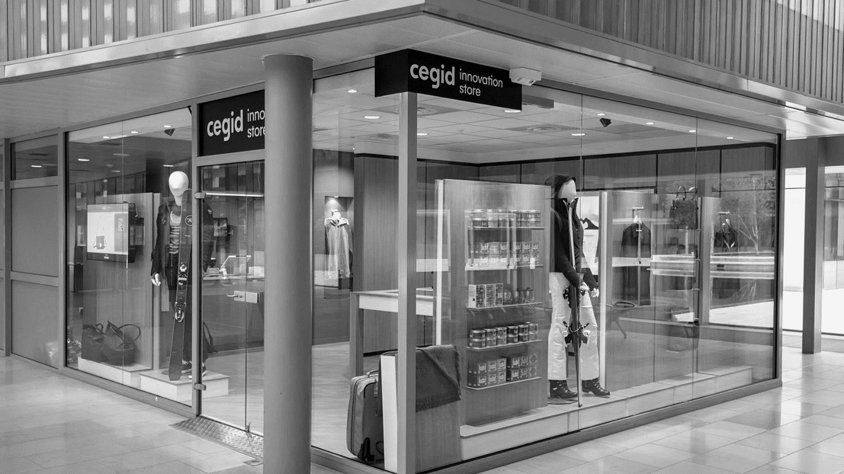
Test &GO
Contact us to take advantage of these offers. Valid until 30th April 2021
www.cegid.com/retail
RETAIL THE NEW WAY

